Slide 1

SAP UI5 & FIORI
Srinivas
Day – 3

Slide 2

Agenda – Day 3
Changing the default Model at run time
Element Binding
Event Object concept
What is Resource Model.
Steps to create a Resource Model.
Formatter
How to create a formatter
Using the predefined Formatter Classes
User Experience V/S User Interface
UI5 vs Fiori
What is Fiori?
Structure of Fiori App
Introduction to Component.js File

Slide 3
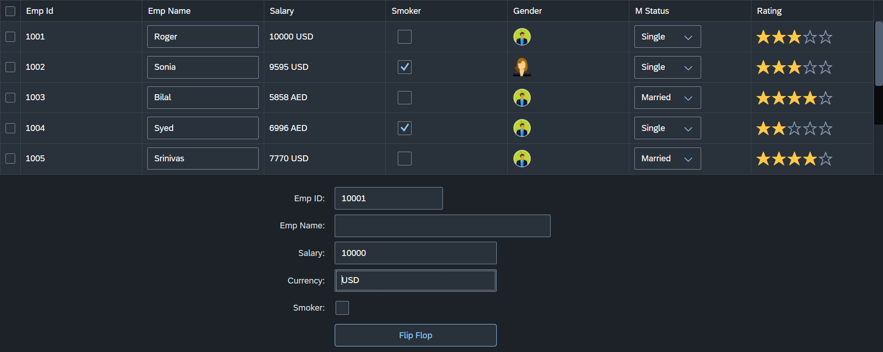
Hands – on: Changing the default Model
Now we will change the default model in in the application on press of a button in the ui.
For this we will create a Flip button on the ui the default model bind to the application will be changed every time. (Flip Flop).
Along with that we will set the Visible number of rows in the Table to 5.
Code Links:-
Main.controller.js
Main.view.xml
dataset.json

Slide 4
Element Binding
To Understand the element binding first we have to understand about the what is element.
Element : Data related to the table inside the model memory is called as element ,
so, if we have 10 elements in the model we will get eventually 10 rows in table at runtime.
“empTab": {
"empId": 1,
"empName": "Roger",
"salary": 10000,
"smoker": false,
"currency": "INR",
"mStat": "S",
"rating": 2
}, ,
{
"empId": 2,
"empName": "Ananya",
"salary": 20000,
"smoker": true,
"currency": "INR",
"mStat": "S",
"rating": 4
}
Id | Name | Salary
1 | Roger | 10000
2 | Ananya | 20000
Element 0
Element 1

Slide 5
Event Object Concept
Every UI5 event handler method will be entitled to receive an object free in the function, this object is know as event object.
This object is responsible to carry important information about the event.
For example : the rowSelectionChange event’s event object will let you know about the index of the row selected by the user.
Every Event object in SAPUI5 have exact 3 same function which are generic :
getSource() : will give the object of the source control from where event was originally generated. We can get object of the control, we can use it without giving an id.
getParameters() : every event carries a lot of the information about the user action e.g. row index of the selected row of the table. All this info come in form of parameters.
getParameter() : if we want to get single parameter value we can get it using this getParameter() function.
Note : best practice to use event object is put oEvent in the function’s parameter and using a hard debugger and then check the information got by the event object in browser’s console.

Slide 6
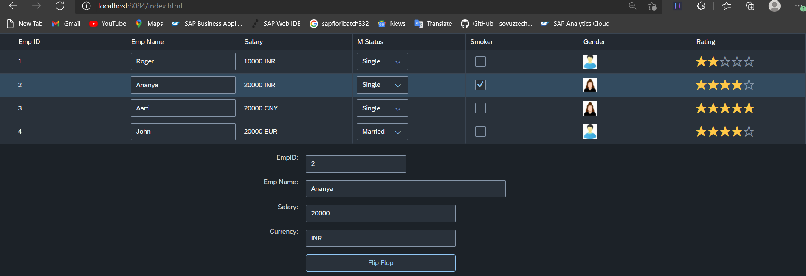
Hands – on: Element Binding
Make the table rows from multiselect to single select.
On select one row the data of that row have to shown in the SimpleForm by using the event object and element binding discussed in the previous slides.
Code Links:-
Main.view.xml
Main.controller.js

Slide 7
Resource Model
We build software for international audience, we cannot just hardcode every screen element in English, if it requires multi-lingual support, we need to add resource model.
i18n → Internationalization : Make the app available for international usage, which means supporting multiple languages.
There are 2 job roles in the process:
UI5 Consultant
Language Expert KM
?sap-ui-language=hi
Implement the model to provide support for internationalization
Translate the texts to provide support in multiple languages
I18n.properties
TEXTS
Language specific

Slide 8
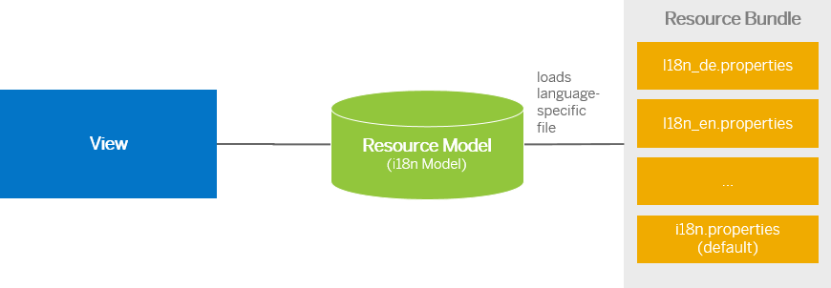
Steps to Create a Resource Model
Create resource bundle which includes label field
Create a folder i18n and inside this folder the file named i18n.properties for default labels.
And i18n_langcode.properties for different languages
Set The model
For more information about i18n you check the link
https://openui5.hana.ondemand.com/1.34.9/docs/guide/831039835e7c4da3a8a0b49567573afe.html
We can change the language of the app by adding ?sap-language=language_code at the end of the URL of the app. Example for Hindi we will write ?sap-language=hi

Slide 9
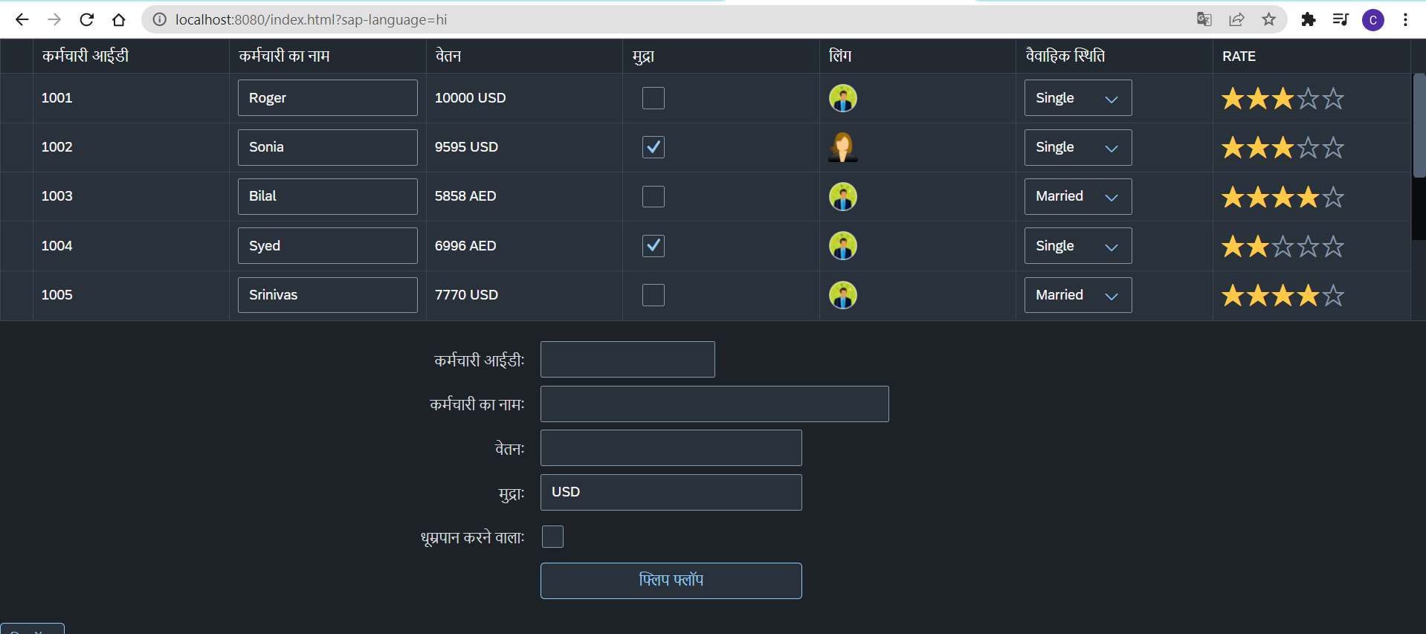
Hands – on: Resource Model
Now we will see how the language of an app is changed using the i18n file.
We have to create a folder ‘i18n’ in webapps folder and in the folder, we have to add files named ‘i18n.properties’ and one another file named according to the language we want. For example:- for Hindi language the file is named as ‘i18n_hi.properties.
Code Links:-
Main.view.xml
Main.controller.js
model.js
i18n.properties
i18n_hi.properties

Slide 10
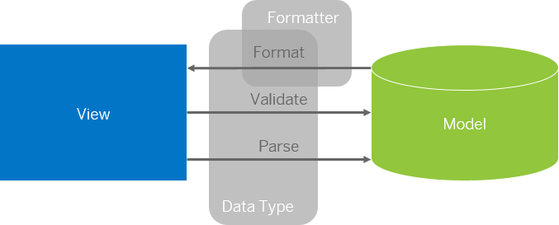
Formatter in SAP UI5
Formatters are used to define the formatting of data on the UI while data types work in both directions: they format the data on the UI and parse and validate user input that is entered.
Formatter is a function; This function gets called JUST Before the binding takes place with the view.
Formatter file is placed in a folder in webapp folder, and the file can be named anything with the .js extension.

Slide 11
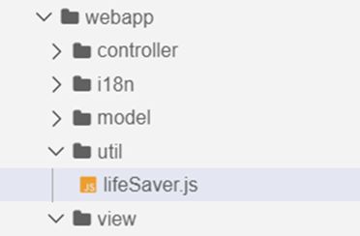
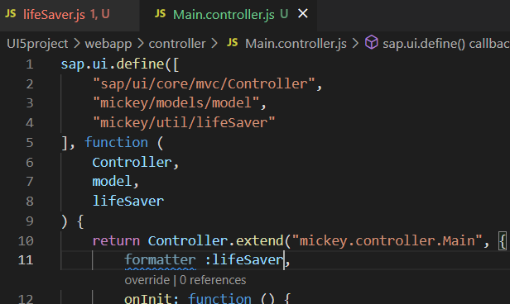
How to create a formatter
To create a formatter first create a utils or util folder inside the webapp folder.
Now create a file lifesaver.js inside the util folder .
Inside the file (lifeSaver.js) create the function(convertUC) for formatting.
After creating this function , inside the controller include it as a dependency and create a global variable at controller level which is accessible in the current view.
Now bind the formatter inside the view by using the second property binding syntax.
{path: ‘ ’ , formatter : ‘.formatter.formatterFunction’}
Formatter
The first dot represent that the it is in the controller

Slide 12
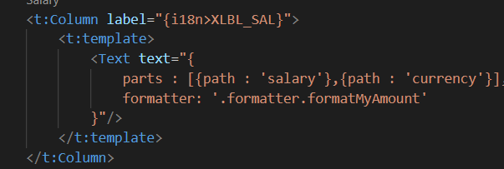
How to create formatter continue….
When we there are two fields bind in one
for e.g:
Here we have to bind in a little different format and the format will be
“{ parts : [{path : ‘salary’},{path : ‘currency’}] , formatter : 'formatter.formatterfunction’ }”

Slide 13
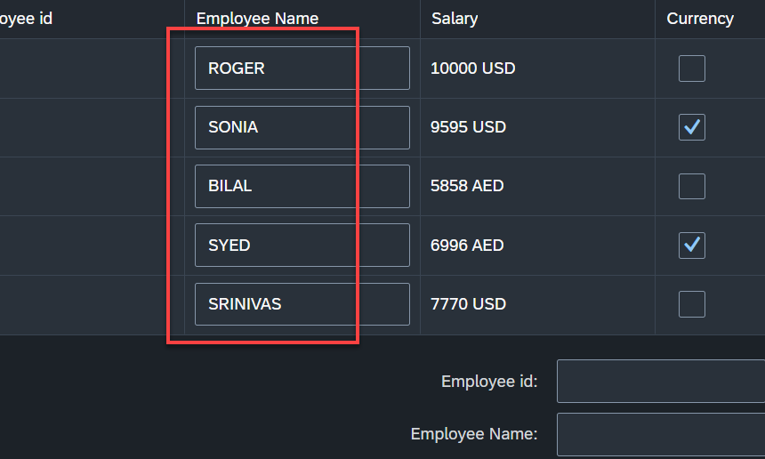
Hands – on: Formatter
Now Create a formatter to format the employee name in table to uppercase.
Code links:-
Main.view.xml
Main.controller.js
lifeSaver.js

Slide 14
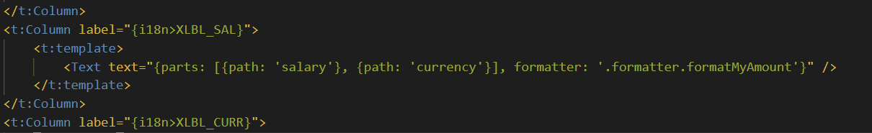
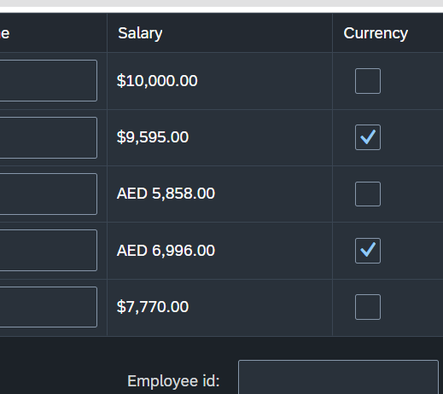
Hands – on: Currency Formatting
Now we will see how to use the sap provided formatter classes to format the data in the UI.
For this exercise we will use the “sap/ui/core/format/NumberFormat” class to format the currency.
Code Links:-
Main.view.xml
lifeSaver.js

Slide 15
Component.js File
Component.js the starting point of all Fiori applications, it is used by Fiori Launchpad to kick-start our app. If an app has Component.js inside, it called Fiori like app.
We will decouple everything from index.html to avoid user starring app w/o launchpad because of security rick of user opening app direct from index file.
It is the wrapper of all the functionality.
The name of the file must be, must be Component.js
It should ideally be created inside the webapp folder
If our app does not have Component.js, we will not be able to integrate our app with launchpad
It is a class which inherits from sap/ui/core/UIComponent standard class. We inherit to reuse the functionality offered by SAP like routing.
When app starts, UI5 framework will scan your project’s base directory to check if it has a file with exact name Component.js
The component file calls the manifest file, and we keep all app level configuration inside the manifest file.

Slide 16
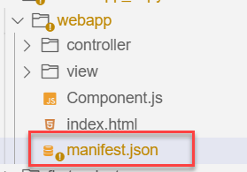
Manifest.json file
manifest.json is also knows as application descriptor file. When someone look at my application, my application descriptor will express all the necessary properties.
It contains all the configuration for our application.
manifest.json is a file which contains all the properties and initialization of our app. When app starts SAPUI5 framework will read this file and generate necessary artefacts out-of-box for us.
It is written in JavaScript Object Notation (JSON) format.
Reasons why we need manifest:
Once upon a time, I was in goa and enjoying my drink on beach, suddenly my phone rings and guess who is on the other side? You have developed a Fiori app last week and left for vacation, today we have a customer ticket and I am sitting with one your colleague, unable to understand what you did? Can you come and connect for some time.
A team member is leaving our team, he/she has developed 20 Fiori apps and now you suppose to take handover, she/he is not cooperating because they leaving, how will you hold on to the code?
SAP Delivers 1000s Fiori apps but they don’t send mobile no. of Labs developer. How will we understand where and what app is doing?
Documentation for manifest.json file: https://sapui5.hana.ondemand.com/#/topic/be0cf40f61184b358b5faedaec98b2da

Slide 17
Section of manifest.json
sap.app contains id, type, i18n, applicationVersion, title, description, dataSources.
sap.app
sap.ui contains technology, icons, deviceTypes, supportedThemes
sap.ui
sap.ui5 contains different components
rootView, dependencies, contentDensities, models, routing etc.
sap.ui5

Slide 18
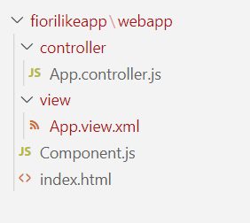
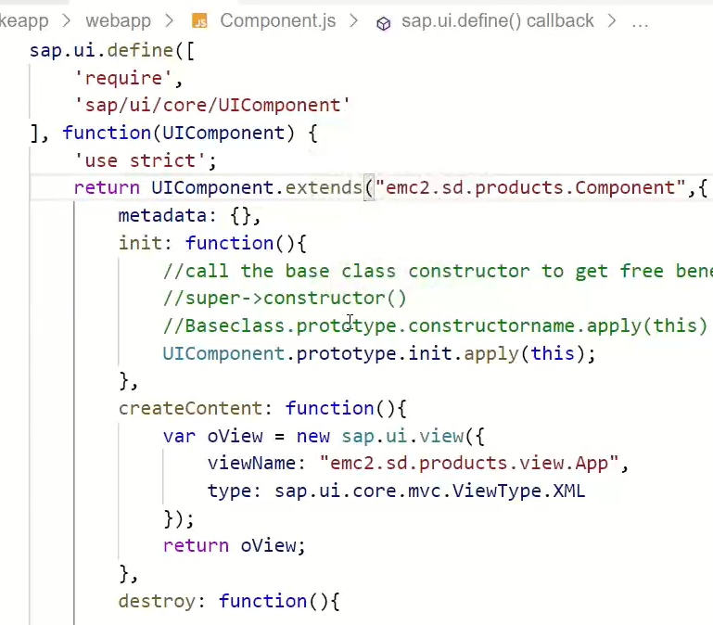
Hands – on: Create our first Fiori Like app
Create a new folder named fiorilikeapp in our projects directory, using the command mkdir fiorilikeapp.
Now navigate to the newly created folder using the command cd fiorilikeapp, and then create a webapp folder inside this newly created folder using the command mkdir webapp. Then move inside this folder using command cd webapp.
Now create two files in the webapp folder using the commands touch index.html and touch Component.js
After this create a App view and App controller in the respective view folder and controller folder.
Once the files are created paste the code from below links.
Code links:
index.html
Component.js
App.view.xml
App.controller.js
Namespace naming convention: “company.area.project”
Example:
ibm.fin.ar
emc2.fin.ar
ibm.hr.payroll
ibm.fin.ap

Slide 19
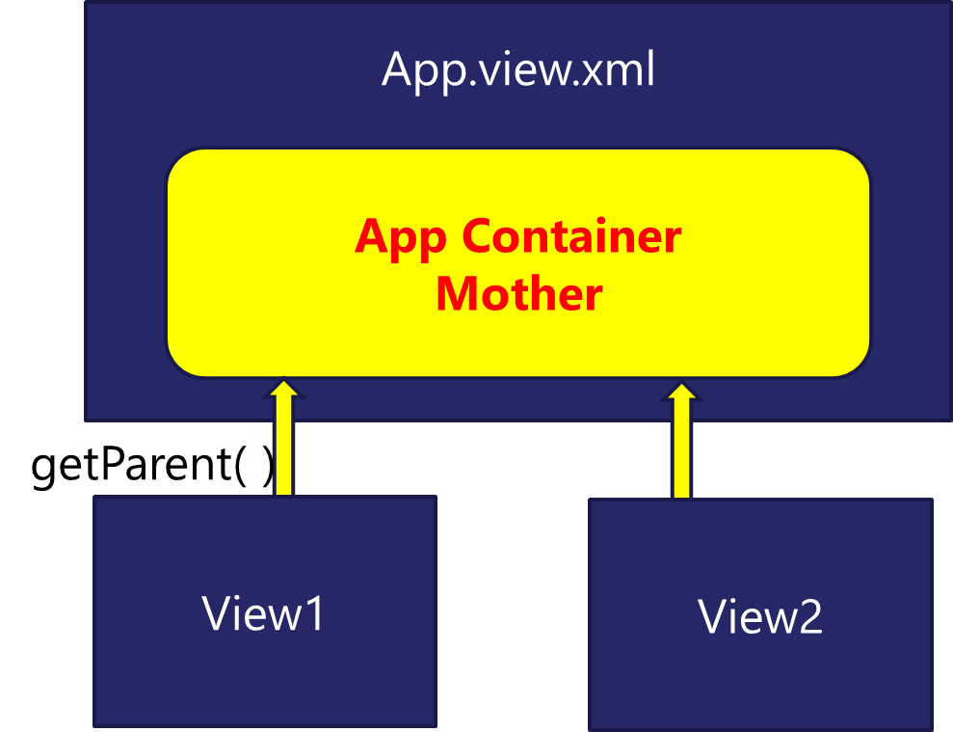
App Container
Most of the Fiori app developed in the industry used to have more than one view. To work with multiple views, we use the concept of Parent View in the Fiori application. Which means all the views are loaded in one Parent View(App View) which then calls the view we want to display to the user.
The App view will behave as a container for other views.

Slide 20
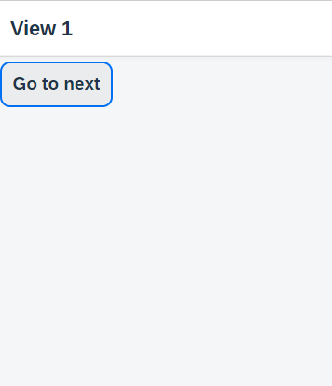
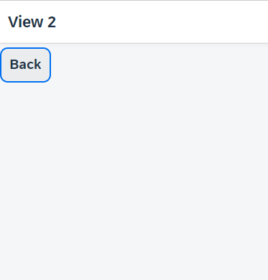
Hands – on: Working with multiple views
Now to understand how the app container works we will add two new views (View1 and View2).
Similarly we have to create a View1 controller and View2 controller.
Since we are using multiple controllers we should also create a Base Controller to inherit the controller class at one place.
Once these files are created, copy the code from below links.
For this exercise we will create a Button on both View1 and View2. On press of that buttons we will navigate to the another view. View1 to View2 and vice-versa.
Code Links:
App.view.xml
App.controller.js
View1.view.xml
View1.controller.js
View2.view.xml
View2.controller.js
BaseController.js
Component.js

Slide 21
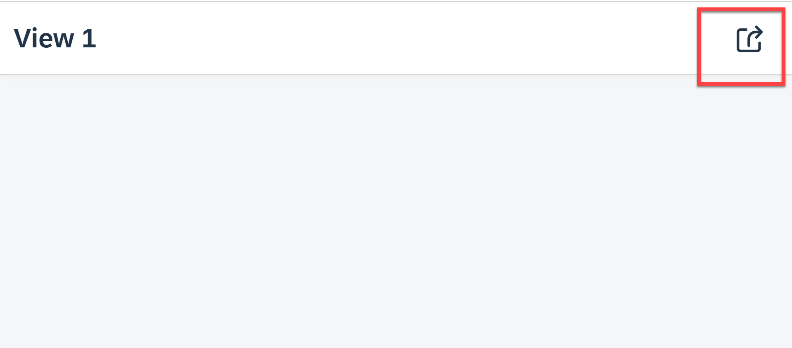
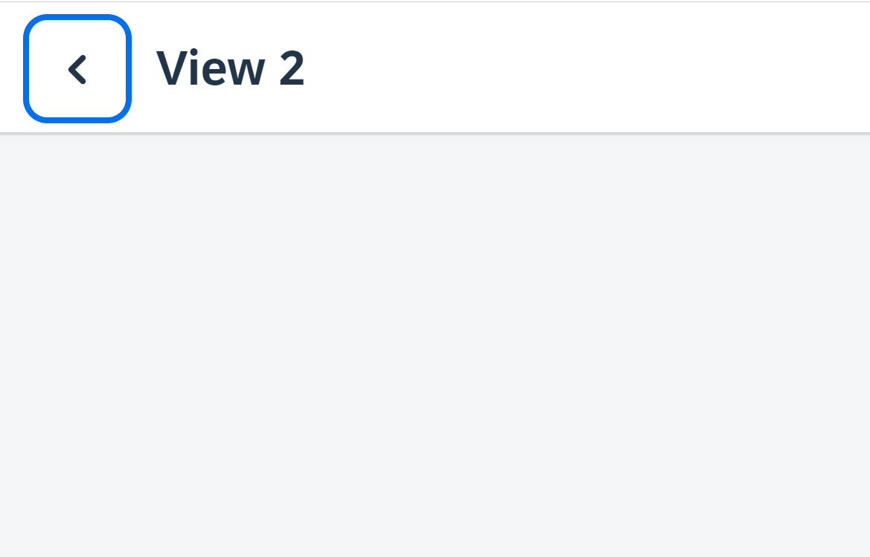
Hands – on: Header Navigation Buttons
As we see in most of the application the Navigation button are place inside the navigation bar at the top.
So we, will move the button to the Nav bar using the headerContent aggregation of the sap.m.Page control.
The standard page control also provides a some properties to add the Nav button without using the custom control.
Code Links:
View1.view.xml
View2.view.xml

Slide 22
sap/ui/core/mvc/Controller
BaseController
X = 10
View1
View2
App
X = 10
X = 10
X = 10

Slide 23
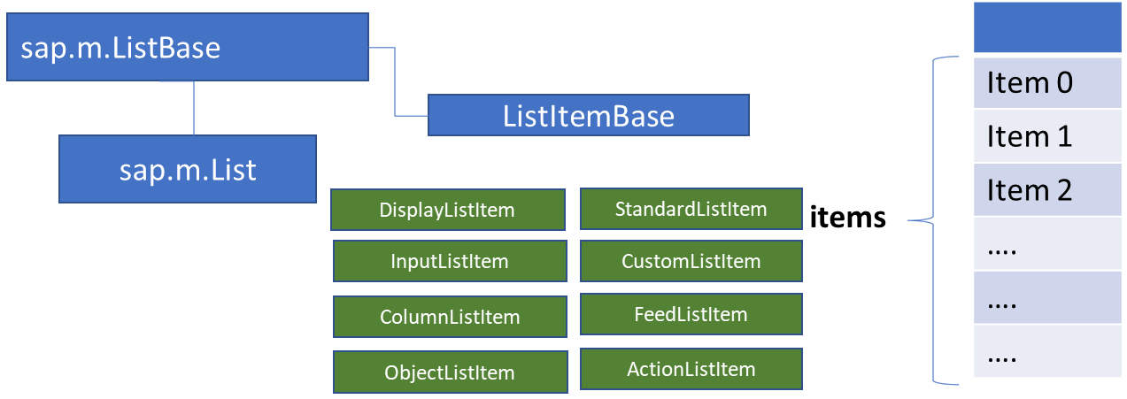
List Control
The list contains various list items. These items can be of various types depending on the use case and on the content they have. SAPUI5 already provides the most common list items in SAP Fiori in the form of controls, although custom list items can also be created if necessary.
Reference: https://sapui5.hana.ondemand.com/#/entity/sap.m.List
A List control is a single column table with multiple items inside. We will have a list header and items as aggregation.

Slide 24
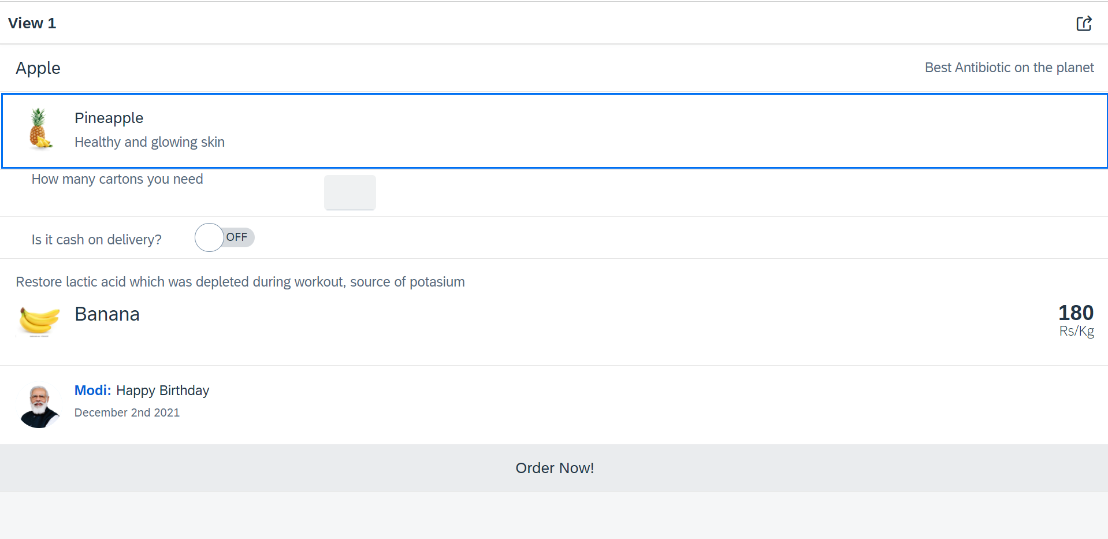
Hands – on: List Controls in UI5
Now we will add some basics list controls in the View1 of our application.
Code Links:
View1.view.xml

Slide 25
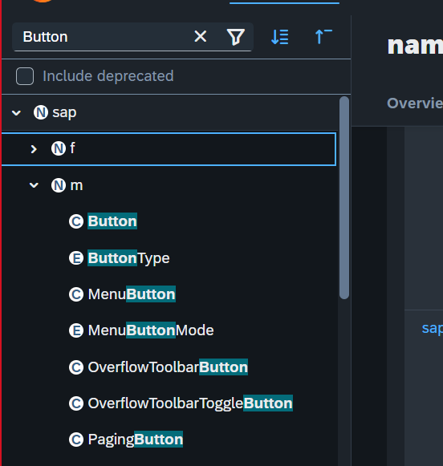
N – namespace – library
C – Class
E - Enumerator - constants

Slide 26
Agenda – Day 9
Creating model in Manifest.json
Search Functionality
List Modes and Grouping
Header and Footer Toolbar
Worklist Application
Split App Container
Loading Empty view at Start
Performance Issues in our app
Introduction to Router
Routing Configuration
Route Match Handler
Icon Tab Bar
Responsive Table (sap.m.Table)

Slide 27
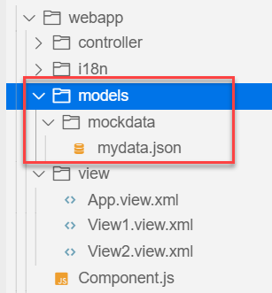
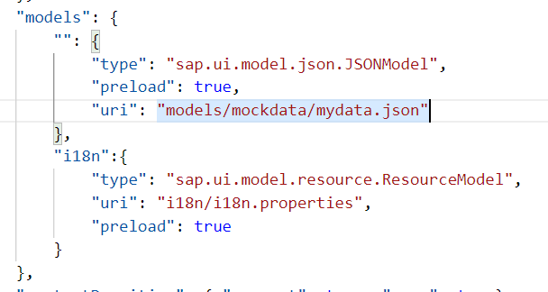
Hands – on: Models in manifest.json
Now we want to bind our list control to a model to show the multiple records using the list control.
For this first we need a file with some demo data related to the fruits, so we have created a file which has three entity sets:
fruits – name, color, type (neutral, citrus, alkaline),price, healthBenefit, unit, status (available, discontinued, out of stock), image (url from google) – 20
cities – name, state, famousFor, population – 10
supplier – name, city, country, contactPerson, phone, email, sinceWhen – 10
Now we will create a models folder in the webapp and in the models folder we will create a folder named mockdata, we will put our json file in this folder.
Code Link:
manifest.json
mydata.json
View1.view.xml

Slide 28
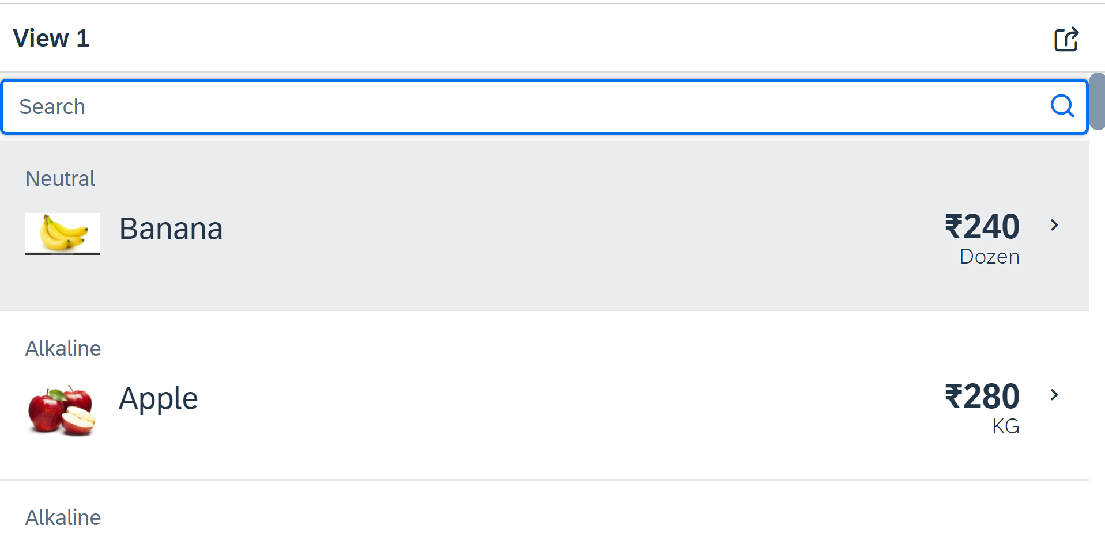
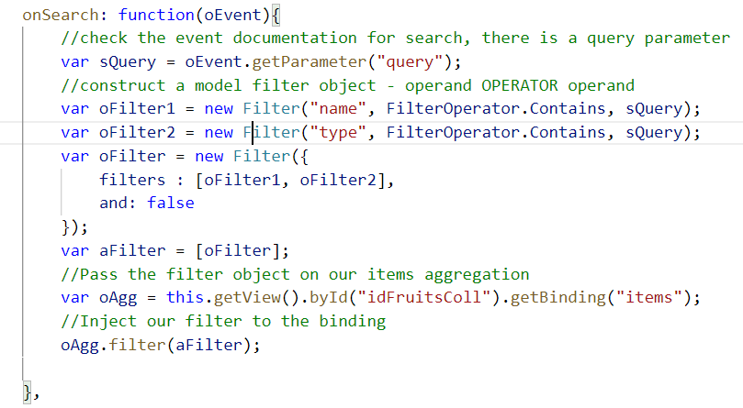
Hands – on: Search Functionality
Nowadays we come across many web pages that provide data in the form of lists or tables. These lists are enabled with search functionality, i.e., as the user types in into the search field and press enter then the data in the list is filtered according to the value in search field.
Code Link:
View1.view.xml
View1.controller.js

Slide 29
List Modes
The mode property defines the appearance of the left area of a list item.
Lists have properties and events and they contain list items that inherit from sap.m.ListItemBase, which provides navigation, selection and event features.
Delete
SingleSelect
01
04
only one list item can be deleted via provided delete button
Right-positioned single selection mode (only one list item can be selected).
01
04
MultiSelect
You can edit this text
SingleSelectLeft
02
05
02
more than one list item can be selected
05
Left-positioned single selection mode (only one list item can be selected).
03
06
None
03
06
SingleSelectMaster
no selection
Selected item is highlighted but no selection control is visible (only one list item can be selected).

Slide 30

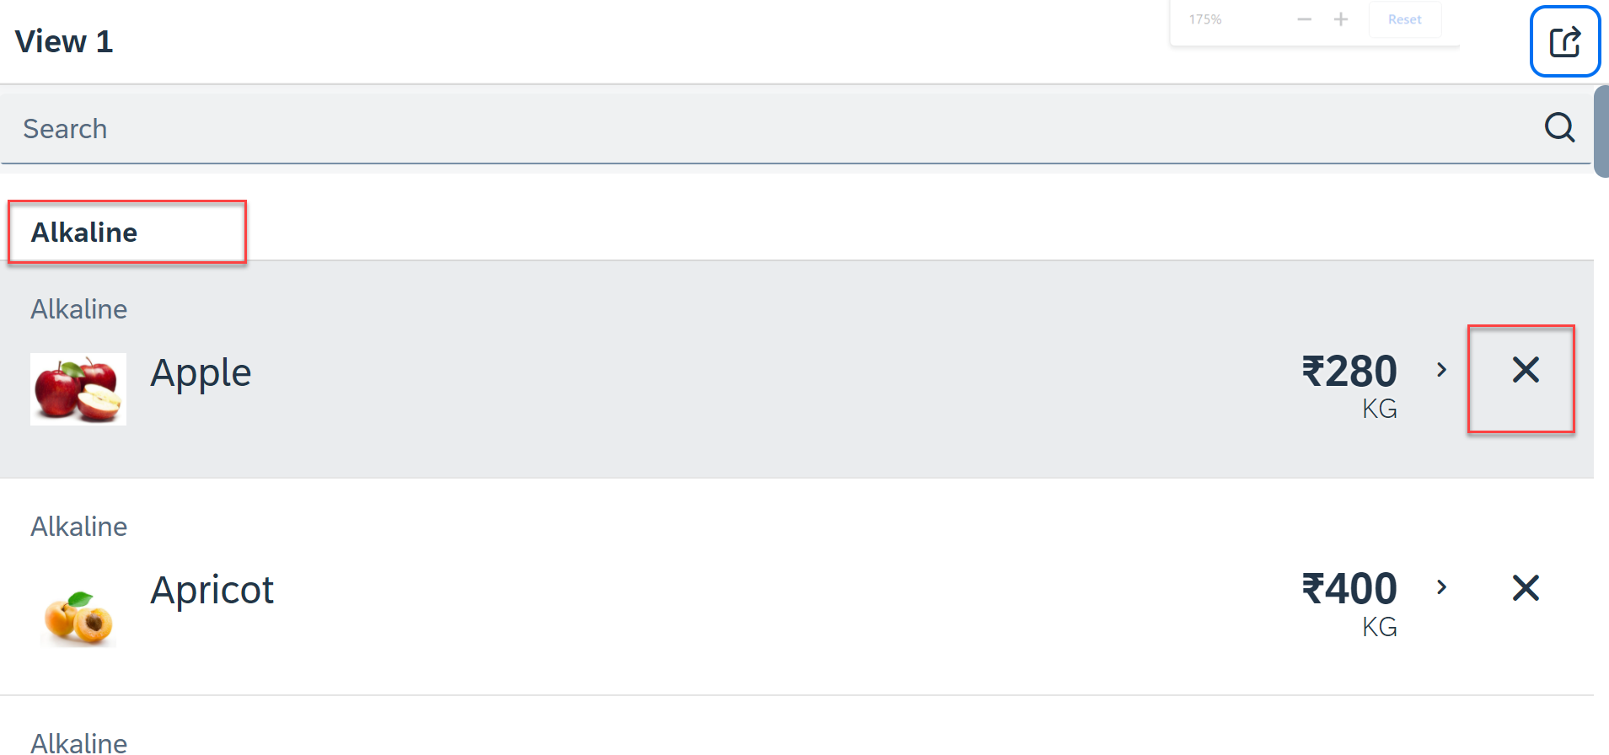
Hands – on: List modes and Grouping
Now we will look at the different type of List mode provided by the UI5.
Along with that we will Implement the Press event, Selection change and Delete Event in the List Control.
Also we will Group the data according to the type of Fruit.
Code Link:
View1.view.xml
View1.controller.js

Slide 31
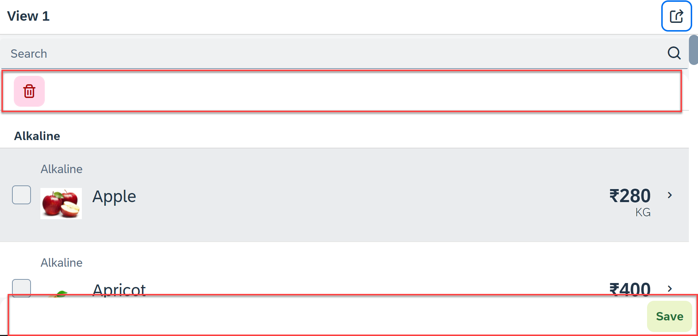
Hands – on: Header and Footer Toolbar
Now we will add a Header Toolbar to the list control and in that we will add a delete button to delete multiple items from the List.
We will also add a Footer toolbar to the page control and in that we will add a save button on press of the save button a alert will be shown to the user.
Code Link:
View1.view.xml
View1.controller.js

Slide 32
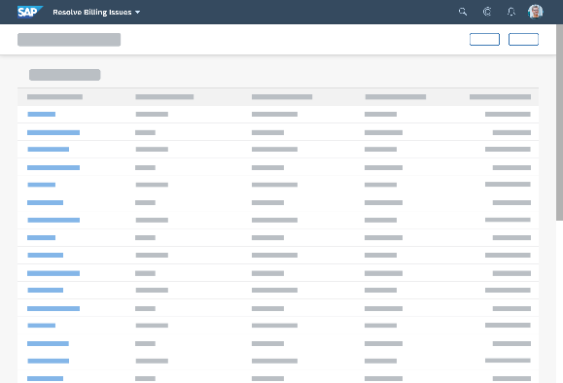
Introduction to Worklist Application
A worklist displays a collection of items a user needs to process. Working through the list usually involves reviewing details of the items and taking action. In most cases, the user has to either complete a work item or delegate it.
When to use:
Users have numerous work items and need to decide which ones to process first.
You want to give users a direct entry point for taking action on work items.
Users need to work with multiple views of the same content (for example, items that are “Open”, “In Process”, or “Completed”). You want to offer tabs for switching between views.
Detail View
List Page

Slide 33
SplitApp Container Control
A split app container control will divide our app into 2 parts, 1st is called master section and 2nd is called detail section. It is used to fully optimize the screen width for desktop apps.
SplitApp Container
masterPages
detailPages
App Container
View1
View2
View1
View2

Slide 34
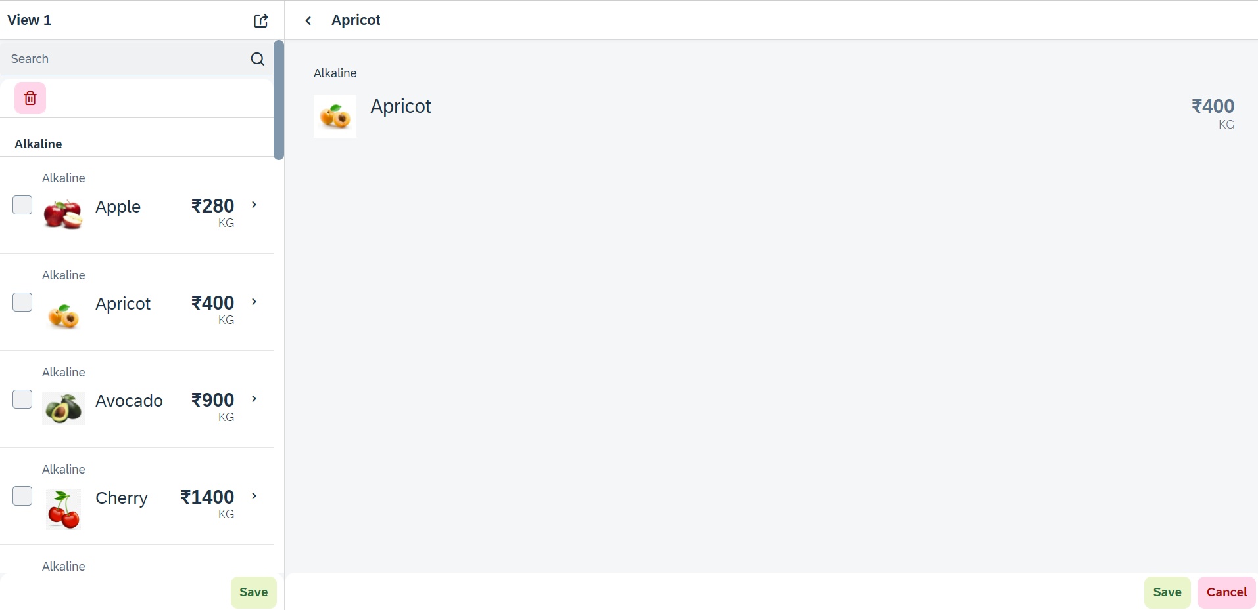
Hands – on: SplitApp (Mater Detail App)
Now we will convert our worklist app to a master detail application.
Once we change the app container, we have to change the method of getting the view object in onNext function.
Code Links:
App.view.xml
Component.js
View1.controller.js

Slide 35
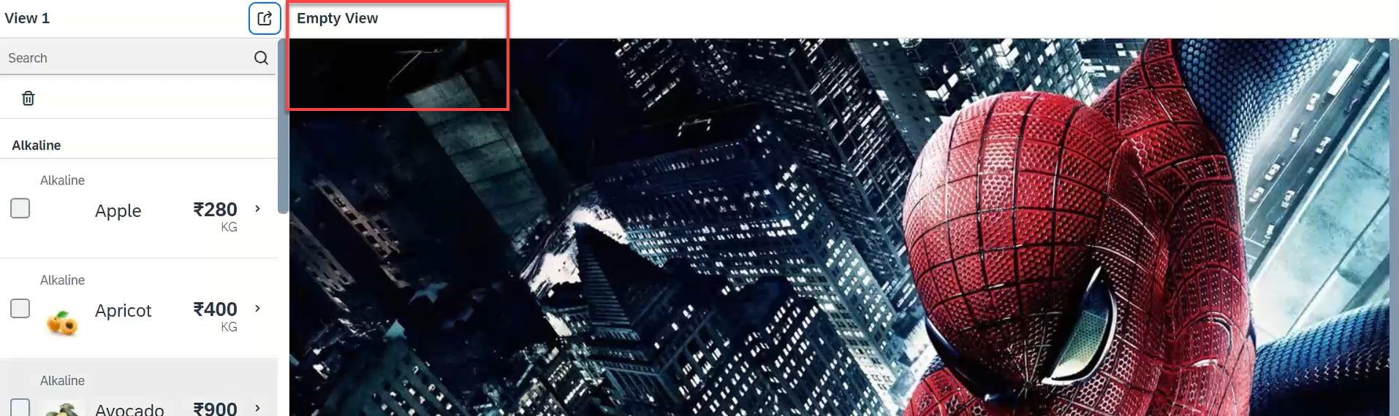
Hands – on: Empty View at start
Now we want to load an Empty view in the detail section when our application starts.
To do this first we need to create one Empty View and Empty controller.
After we need to add the Empty view to the Split App container in the Component.js file.
oAppCon.addMasterPage(oView1).addDetailPage(oEmpty).addDetailPage(oView2);
Code Link:
Empty.view.xml
Empty.controller.js
Component.js
View1.controller.js
This view will be loaded by default

Slide 36
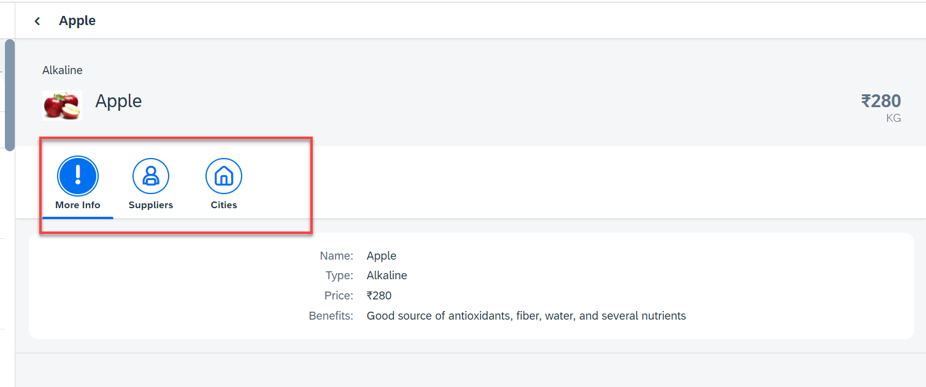
Hands – on: Icon Tab Bar
Now in the View2, we will create a icon tab bar to show the additional data related to the fruits, like Supplier and City data.
For now in the first section we will add a simple form to show the data of fruit.
Code Link:
View2.view.xml

Slide 37
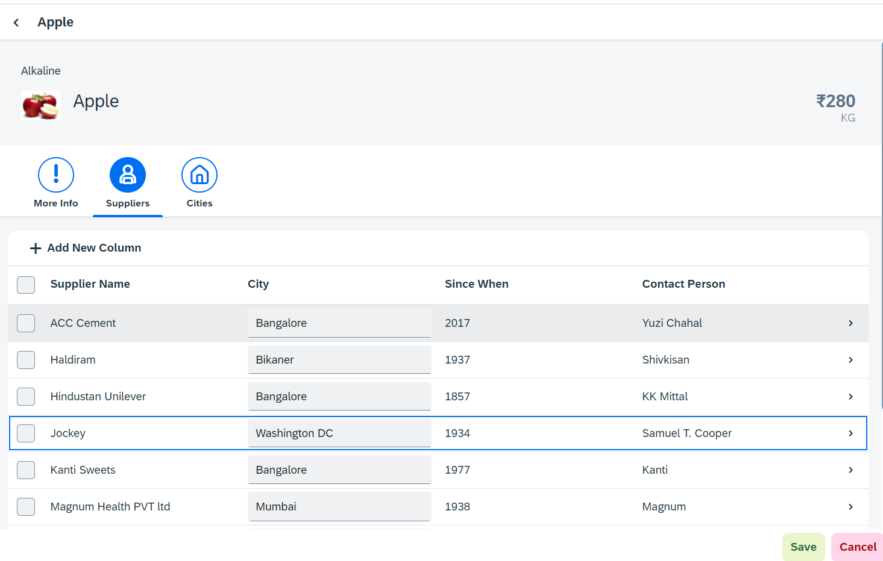
Hands – on: Sap.m.Table (Responsive Table)
Now in the second section of the icon tab filter bar we will add a Responsive table containing the Supplier Data.
Along with that we will add a button in the Header of the table to add a new column.
And on select of a row in the table the table path will be shown in alert message.
Code Link:-
View2.view.xml
View2.controller.js

Slide 38
Performance Issues in our Fiori App
We have used sap.ui.view API to create the object of the view, but it seems that the API is obsolete. Then what is the right way to instantiate our view?
All the view objects are instantiated when app starts, whether we want or not. If user does not navigate to a view, still the view object is getting created. This is a misuse of computation power and slow down our app when number of views are increased/high.
For each view, we are writing more and more code to create object, multiple developers will add this code in different place, because of this the maintenance will be come very expensive even the handover will be very hard.
The browser navigation button (back) is not working properly.
When the refresh of app happens, the application should restore the state of the UI. It should not start all over again. So user will not frustrate applying all the filters again.
When we take a URL of the page and share with colleagues/friends/family, when they open same URL, Eventually they should see the same state of application what I see. Basically we should restore the state of UI as it is in our system.

Slide 39
Router
Router is an object which is provided by SAP UI5 Component (UIComponent).
It is responsible for creating our view objects on demand.
It is also responsible for complete app navigation based on pattern (end point, hash tag).
How to use router:
Get the router object form the UIComponent class.
Call initialize method using the object
The initialize method will SCAN manifest.json to find the routing configuration (mandatory).
Add the routing configuration in manifest.json
rootView – base view we want to load
config – base configuration like view type, path of all views etc.
routes – array of all the targets, patterns and route names
targets – put all the end point target with views which needs to be instantiated and nav.
Sap.m.routing.Router is the class used for Routing and Navigation purpose in SAP UI5 framework.
“Pattern” defines the hashtag that needs to be added at the end of the URL when it is hit.
“name” defines a unique name for the particular route.
“target” defines the target which is defined in targets section

Slide 40
Routing Configuration
Routing Configuration is defined in manifest.json file. It is defined under the “sap.ui5” section.
Routing configuration consists of routes, targets, config, and owner.
rootView
config
routes
targets
This section contains the information about our Root View. The View which works as a container for other views. In this section we provide the path of the view, type and controlId.
This section contains the global router configuration and default values that apply for all routes and targets. We define the router class that we want to use and where our views are located in the app.
Each route defines a name, a pattern, and one or more targets to navigate to when the route has been hit.
Three subsections :-
1. pattern
2. name
3. target
A target defines a view that is or more routes displayed, it is associated with one.
Subsections: -
Overview
detail

Slide 41
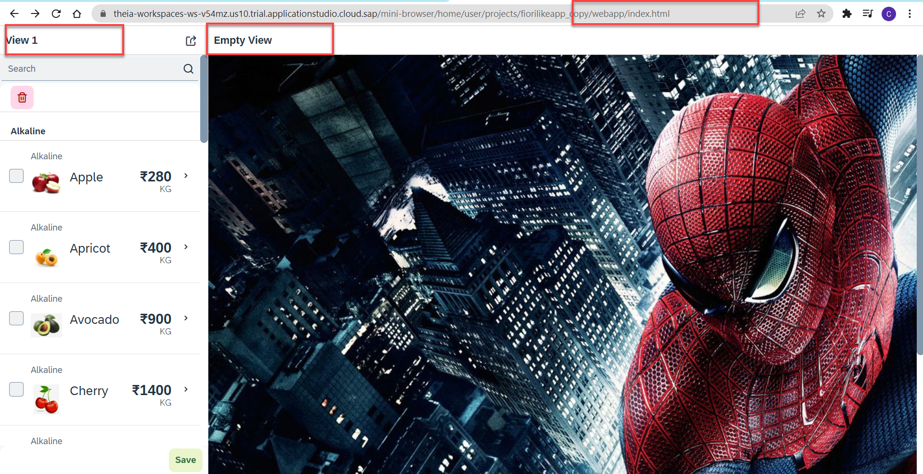
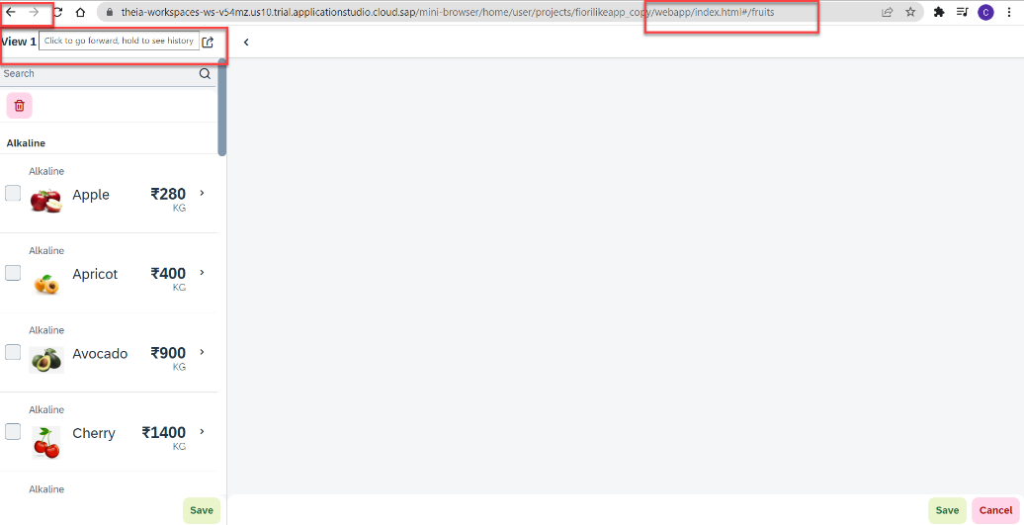
Hands – on: Routing Implementation
Now we need to implement routing in our existing application, for that we have to follow the Steps provided in the previous slides.
We also have to change the navigation in our View1 controller, and make it according to the Router, for that we have to get the router object in the View1 controller and then navigate to the view using the navTo() function.
To get the router object in View1 controller
this.oRouter = this.getOwnerComponent().getRouter();
To navigate to the View2
this.oRouter.navTo("loadMyV2");
Code Links:
manifest.json
Component.js
View1.controller.js

Slide 42
Hands – on: Sap.m.Table (Responsive Table)
Now in the second section of the icon tab filter bar we will add a Responsive table containing the Supplier Data.
Along with that we will add a button in the Header of the table to add a new column.
And on select of a row in the table the table path will be shown in alert message.
Code Link:-
View2.view.xml
View2.controller.js

Slide 43
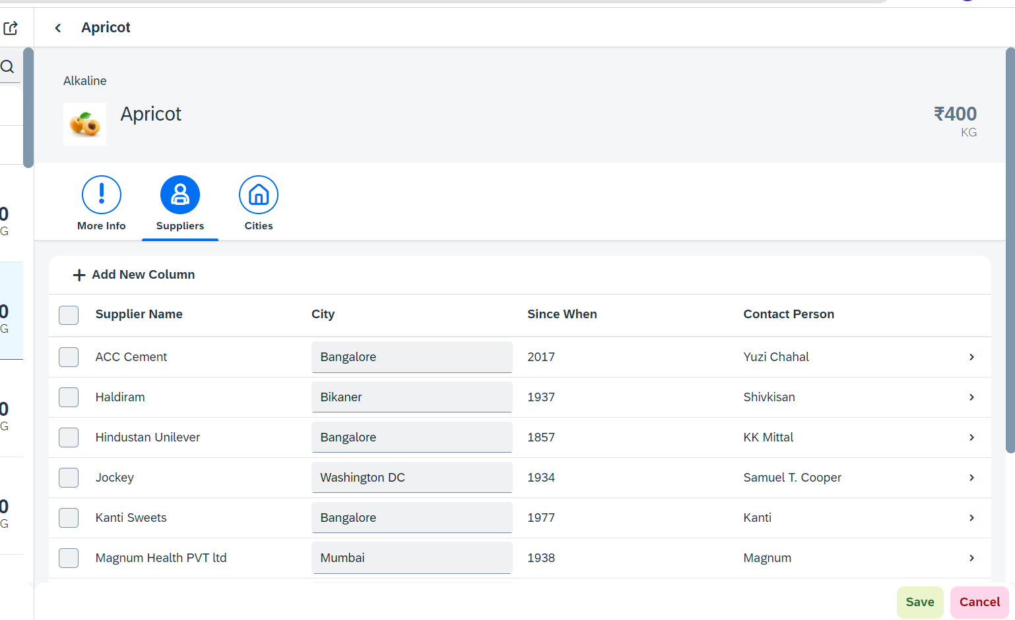
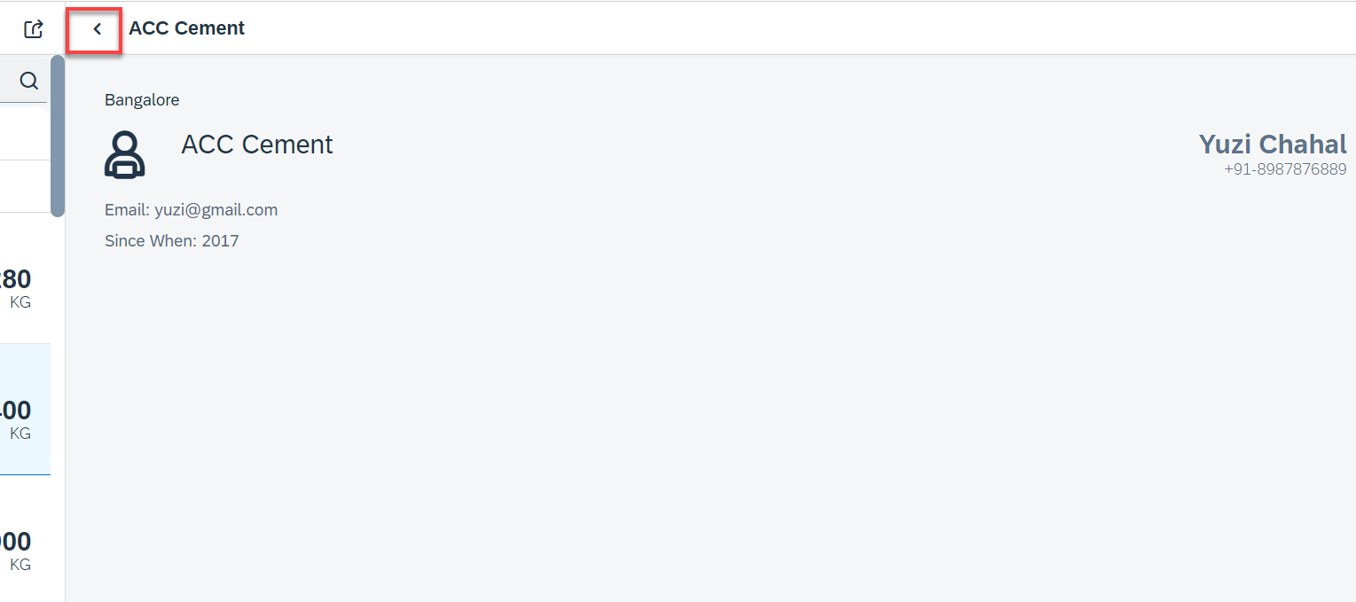
Hands – on: Drill Down from Table and Nav Back
Now we drill down to a new screen where we will show the supplier data for that we will create a new supplier view.
Along with that we will also add the back button login to go back using a nav button on the supplier view.
Code Link:-
View2.controller.js
Supplier.view.xml
Supplier.controller.js
BaseController.js
manifest.js
The nav back logic is written in BaseController so that it can be used at multiple places.

Slide 44
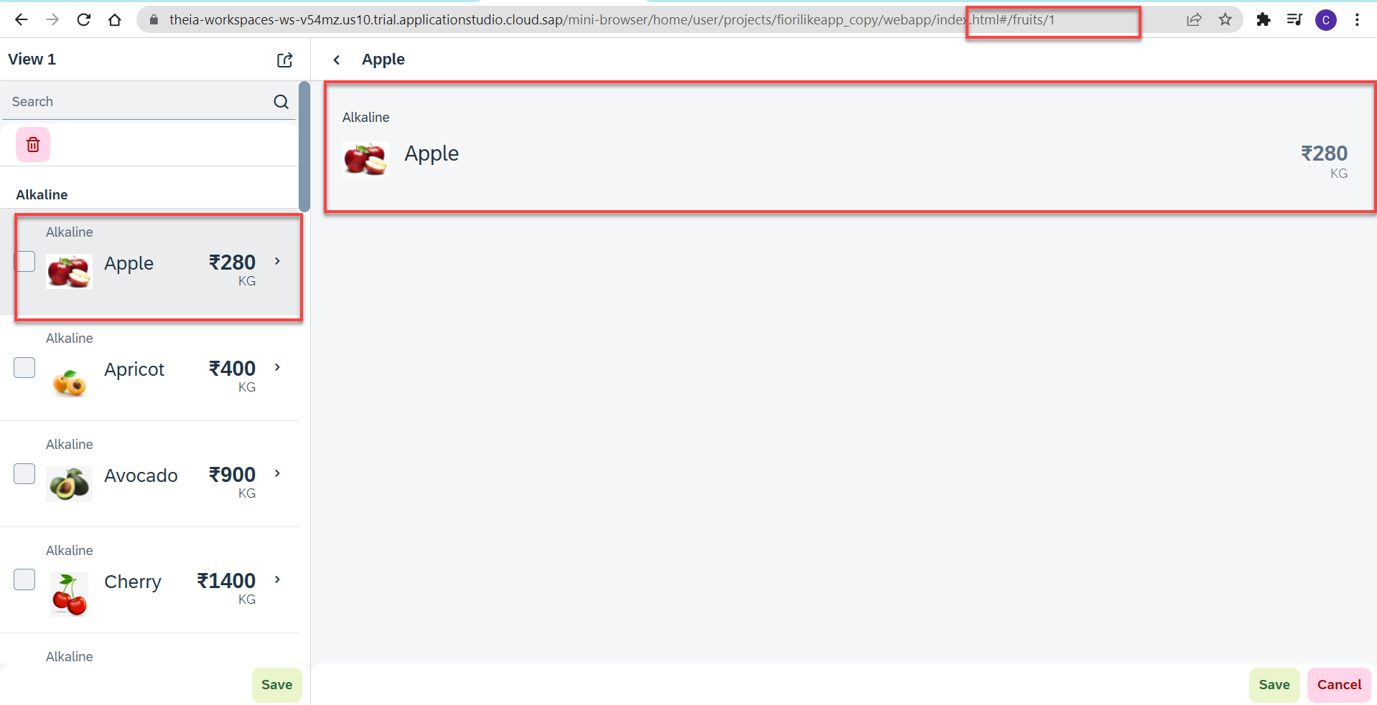
Hands – no: Route Match Handler
Route Match Handler: It is a function which gets triggered every time when Route, End Point, Hash Tag Changes.
Now using the route match handler we will load the data of the selected fruit.
Code Link:-
View1.controller.js
View2.controller.js
manifest.js

Slide 45
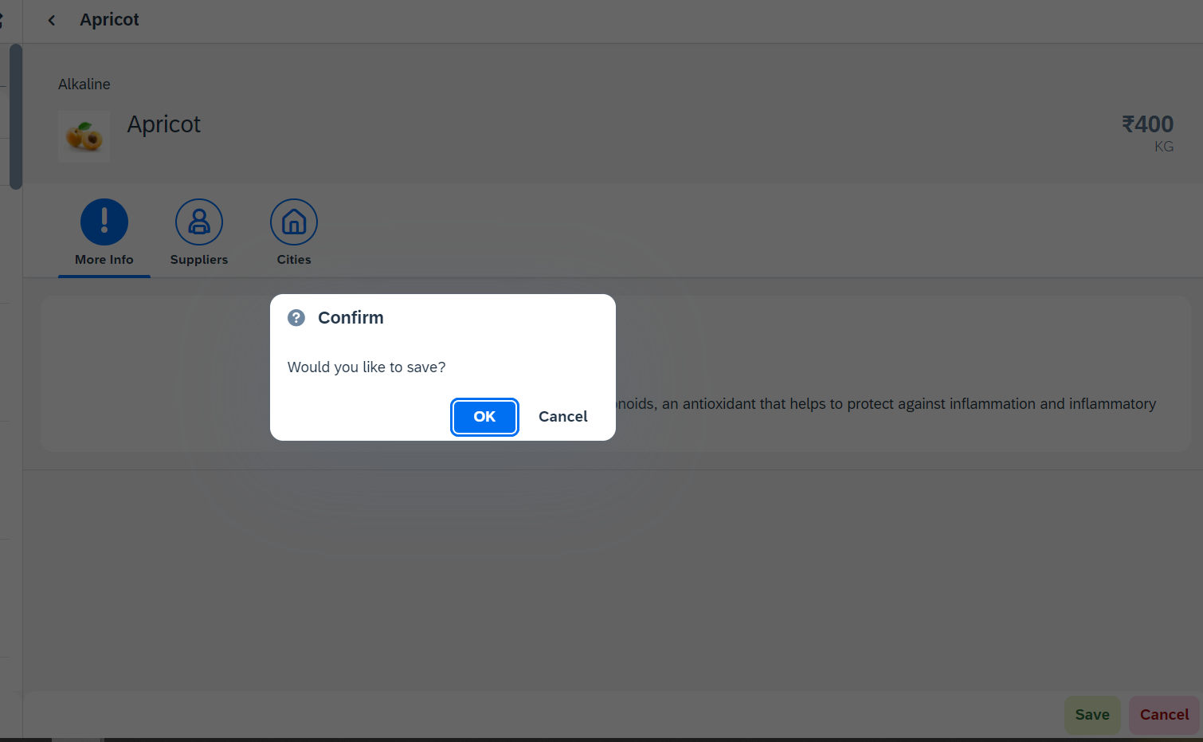
Hands – on: Messages
Now we will see how to use the messages in the ui to get users conformation or to show error to the use.
For this we will see the example of Message Box and Message Toast.
Code Link: -
View2.view.xml
View2.controller.js

Slide 46
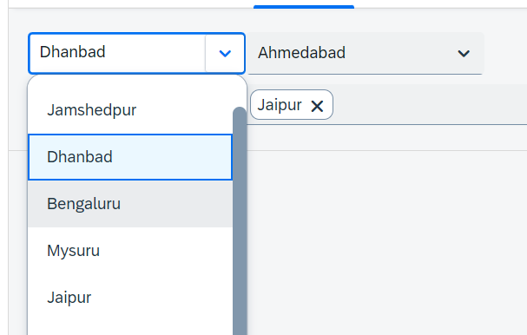
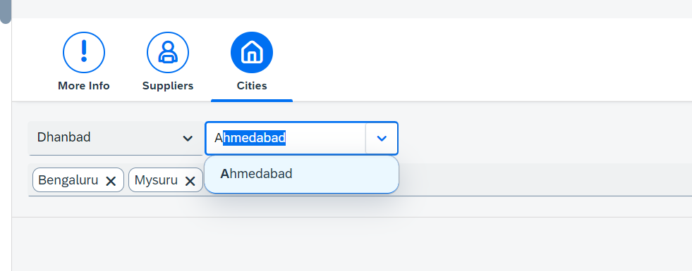
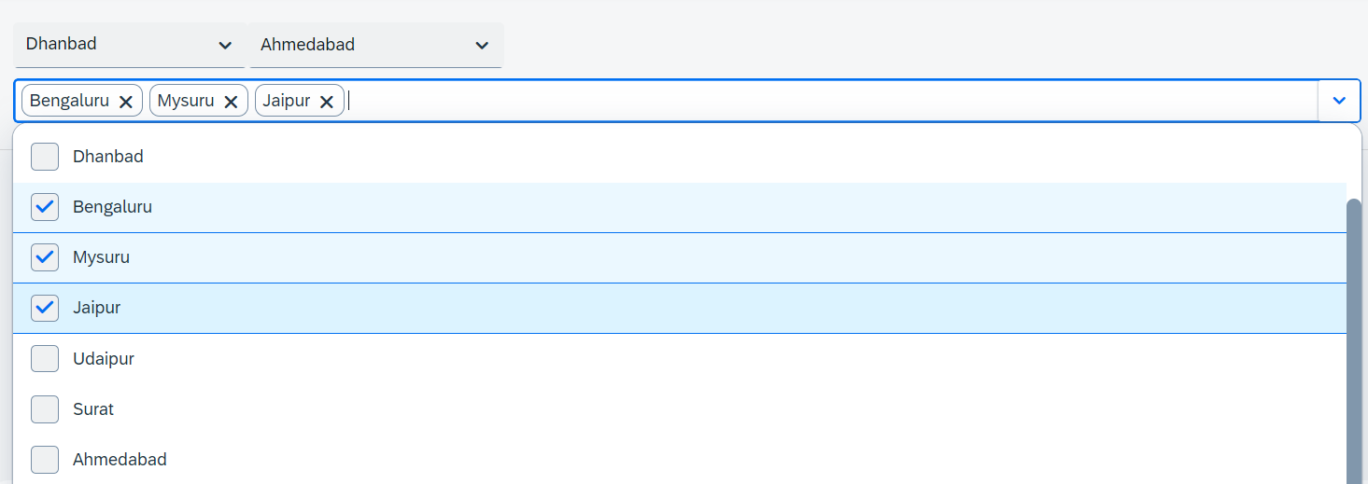
Hands – on: Drop Down Controls
Now we will see the example of some Drop Down Controls present in UI5.
We will load the cities data in the different types of drop downs to see their functioning.
Code Link:-
View2.view.xml

Slide 47
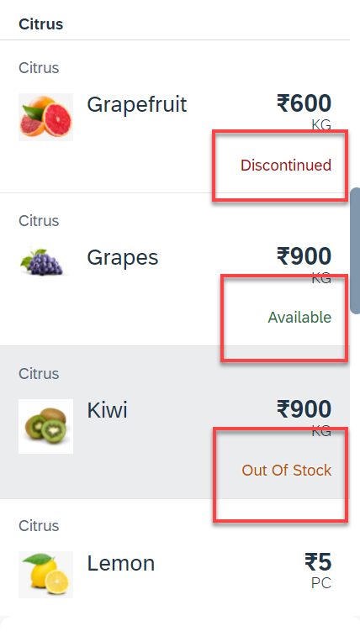
Hands – on: Object Status
Some time we want to show the status any item in different colors, as in our case we want to show the availability of a fruit in different colors like Available, Out of Stock, Discontinued.
For this we will add the object status attribute in the Object list item in View1.
Code Link:-
View1.view.xml
View1.controller.js
formatter.js

Slide 48
Fragments
Fragments are light-weight UI parts. They are used to modularize views. We can reuse a fragment multiple times in same view or other views.
Fragments are used similar as sap.ui.core.mvc.Views, but Fragments do not have their own controllers. Logic related to fragment’s UI elements is written in the host view’s controller.
Fragments are like parasite, they rely on the controllers of the host views.
There are 2 techniques to create and work with fragments
Direct embedding using fragment
Use JS class sap/ui/core/Fragment and use load function to load it
View1
Controller1
Address – street, house, city, country
fragment
B
Event for fragment button
fragment
B
View 2
Controller2
fragment
Event for fragment button
B

Slide 49
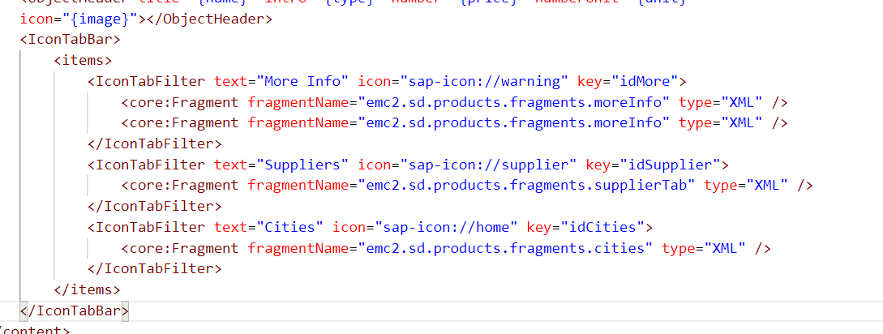
Hands – on: Embedding Fragment in View
For this hands – on we have to create a folder named fragments in the webapp folder and in that folder create fragment files with the extension .fragment.xml.
We will move the Icon Tab bar code to the fragments and will embed them in the View2 to modularize the code of View2.
Create three file in the fragments folder for more Info Section, Supplier Table section and Cities Section.
To including the fragment directly into the XML View use the sap.ui.core.Fragment class as shown below
Ex: <core:Fragment fragmentName=“namespace.fragments.fragmentName" type="XML" />
Code Links:-
View2.view.xml
moreInfo.fragment.xml
cities.fragment.xml
supplierTab.fragment.xml

Slide 50
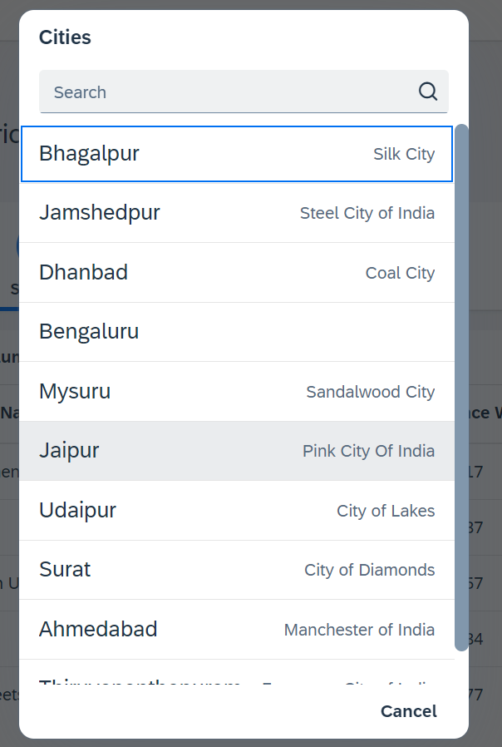
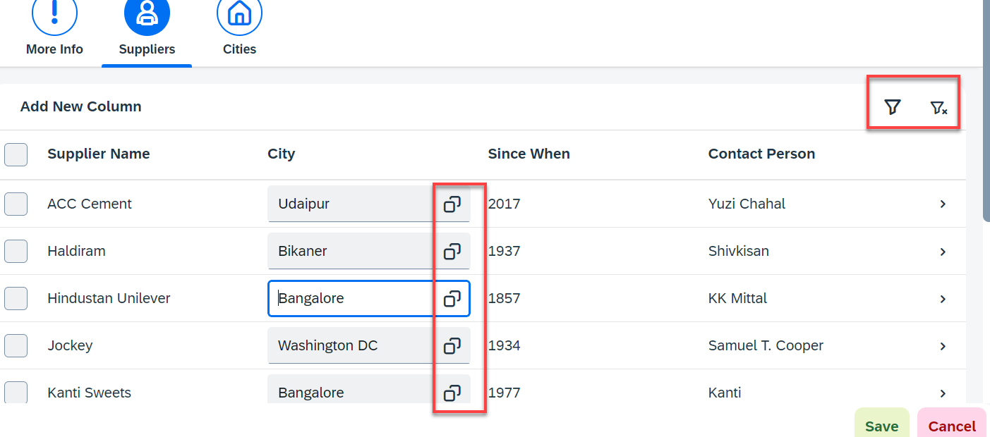
Hands – on: Fragment Use Case 2 (Using JS Code)
My manager asked me to develop following requirements
Add a filter button in the toolbar of the table, and when we click filter icon, it should load a popup with all the list of suppliers. When we select supplier inside filter it should filter data in the table.
Inside the table we have a city field. We would like to enable a value help (F4 Help), when we click on same, it should open a popup which shows all the list of cities on screen.
Part 1: Opening filter popup using the Filter Button.
popup.fragment.xml
supplierTab.fragment.xml
View2.controller.js
Part 2: Opening the Value help popup in the Supplier Table
popup.fragment.xml
supplierTab.fragment.xml
View2.controller.js

Slide 51

End of Day3

Slide 52

Questions

Slide 53

Srinivas

